Slide 1
Natural Capital in the Lower Mainland
Presentation for Emily Carr
Notes:
Facilitator introduces him/herself.
I’ll briefly discuss 4 things:
The concept of natural capital work
DSF’s approach to NC
The Lower Mainland Project
How your work fits into this project

Slide 2
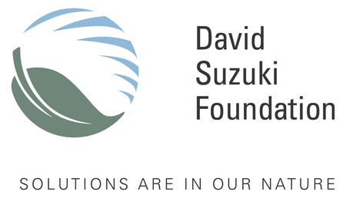
A bit about DSF
Notes:
The David Suzuki Foundation is entering it’s 23rd year. All of our work is ultimately geared towards understanding and communicating how we can live within the limits of nature. So we have quite a range of projects that aim to do this. We work on climate change, endangered species legislation, fisheries management, youth education and engagement, and the protection of habitat. The natural capital project, which your work will contribute to takes a slightly different approach.
This project considers the wide variety of services that nature provides humanity and to the extent possible, puts a price on each service so that it is not over-looked in decision-making. Your work is going to help us address two gaps in this approach:
This work is generally aimed at decision-makers – politicians, directors of finance, and businesses for example, but we would like you’re help reaching out to the general public. A lot of the language is technical, but the ideas are simple and can be very engaging.
We’re not able to value all of the services nature provides. While we might be able to put a price tag on the fish that you buy in the grocery store, or even on the value of clean, naturally filtered water, there are others services such as cultural and spiritual values that we haven’t attempted to estimate. We’d like your help communicating these values to the public.
So keep these goals in mind as I walk you through the basics of this work.

Slide 3
Natural Capital and Ecosystem Services
Ecosystem Services are the benefits of nature.
Natural Capital is the land, air, water, living organisms and all formations of the Earth's biosphere that provide us with ecosystem goods and services imperative for survival and well-being.
Notes:
Whether we are aware of it or not, humans depend on nature for our health and well-being. In short, we rely upon the environment for life-supporting services but also for the raw materials to fuel our economy. Healthy, intact, ecosystems purify our air & water, regulate climate, maintain river flows, treat our waste, mitigate natural hazards, and provide cultural and recreational activities, in addition to providing all of the raw materials for our economy. We call the suite of benefits that nature provides humanity “ecosystem services.” And these benefits originate from healthy ecosystems, which we call natural capital.
These are terms that economists will recognize. Economists talk about forms of capital and types of goods and services. You likely won’t want to use these terms when you’re talking to the public – you might want to talk about the benefits of a healthy environment and nature’s services or benefits.
So why do we need to put a price on them?

Slide 4
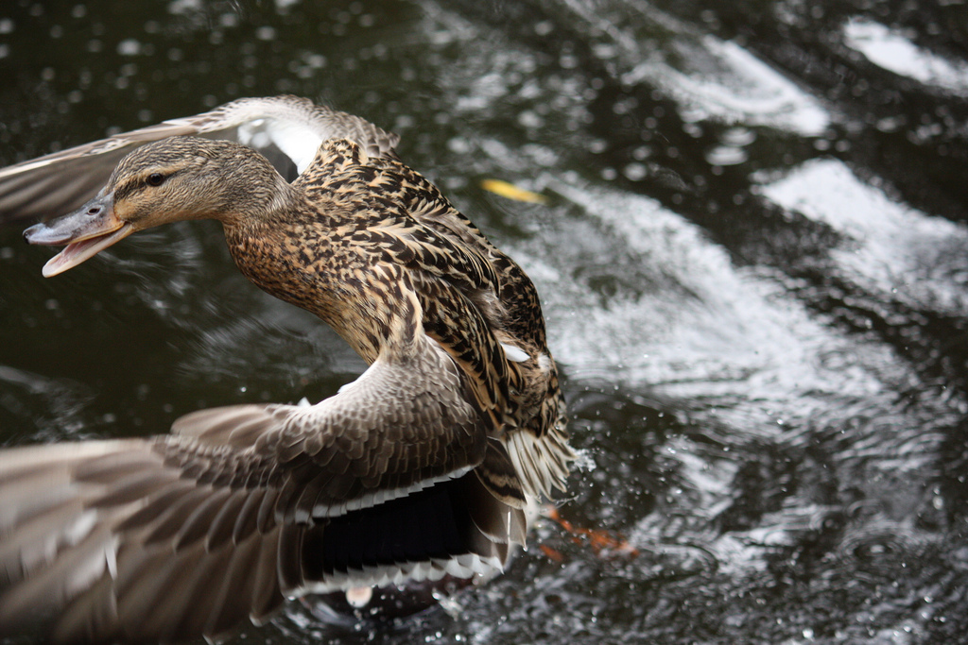
Does money grow on trees?
Why put a price on nature?
Notes:
Natural capital is a way of looking at nature from an economic perspective. While people recognize the importance of the environment to their well-being, the services that nature provides for free are often not accounted for. Globally these benefits are estimated to be worth trillions of dollars per year. Yet they are not monitored, measured or accounted for in decision-making and land-use planning. And we generally don’t realize the impact of that
So despite the importance of natural capital and the services it provides, the benefits we receive from nature are often taken for granted by policy-makers, partly due to a lack of knowledge regarding what they’re worth.
The problem is that given the power that economics has today, this is potentially a very dangerous situation. When you have a society that largely equates well being (or the quality of life) with economic indicators (look at the news or at election platforms) and those indicators fail to track the health of its fundamental inputs, you can find yourself on very shaky ground.

Slide 5

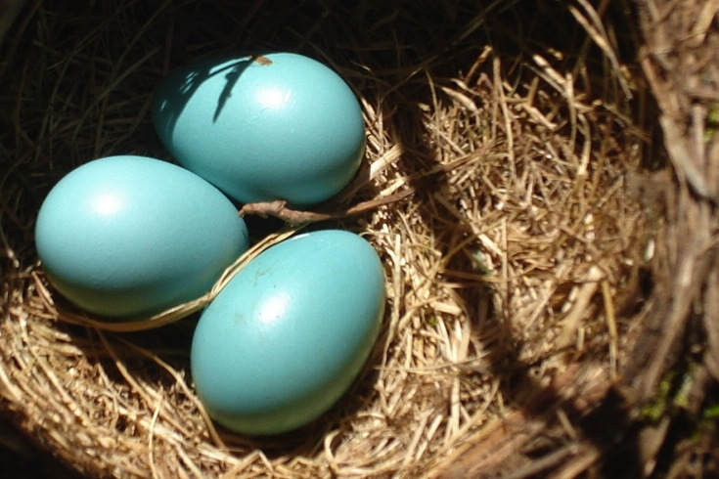

Valuing nature’s benefits in economic terms is a tool to help recalibrate a faulty economic compass
Can we put a price on nature?
Notes:
Putting a price tag on nature can be disturbing to some. Intuitively, we know that nature has intrinsic value and that we miss something important when we attempt to assign an economic value. And ultimately, the estimated benefits provided are likely a conservative estimate, due to our incomplete understanding of all the benefits provided by nature and the intrinsic value of nature. The ecosystem service values, however, provide an opportunity to rigorously assess the current benefits of nature, as well as the potential costs of land use change.
Remember: valuing nature’s benefits in economic terms is a tool to help “recalibrate a faulty economic compass”.
Although there is no truly right way to fully value a forest or river, there is a wrong way, which is to give it no value at all when making development decisions.

Slide 6

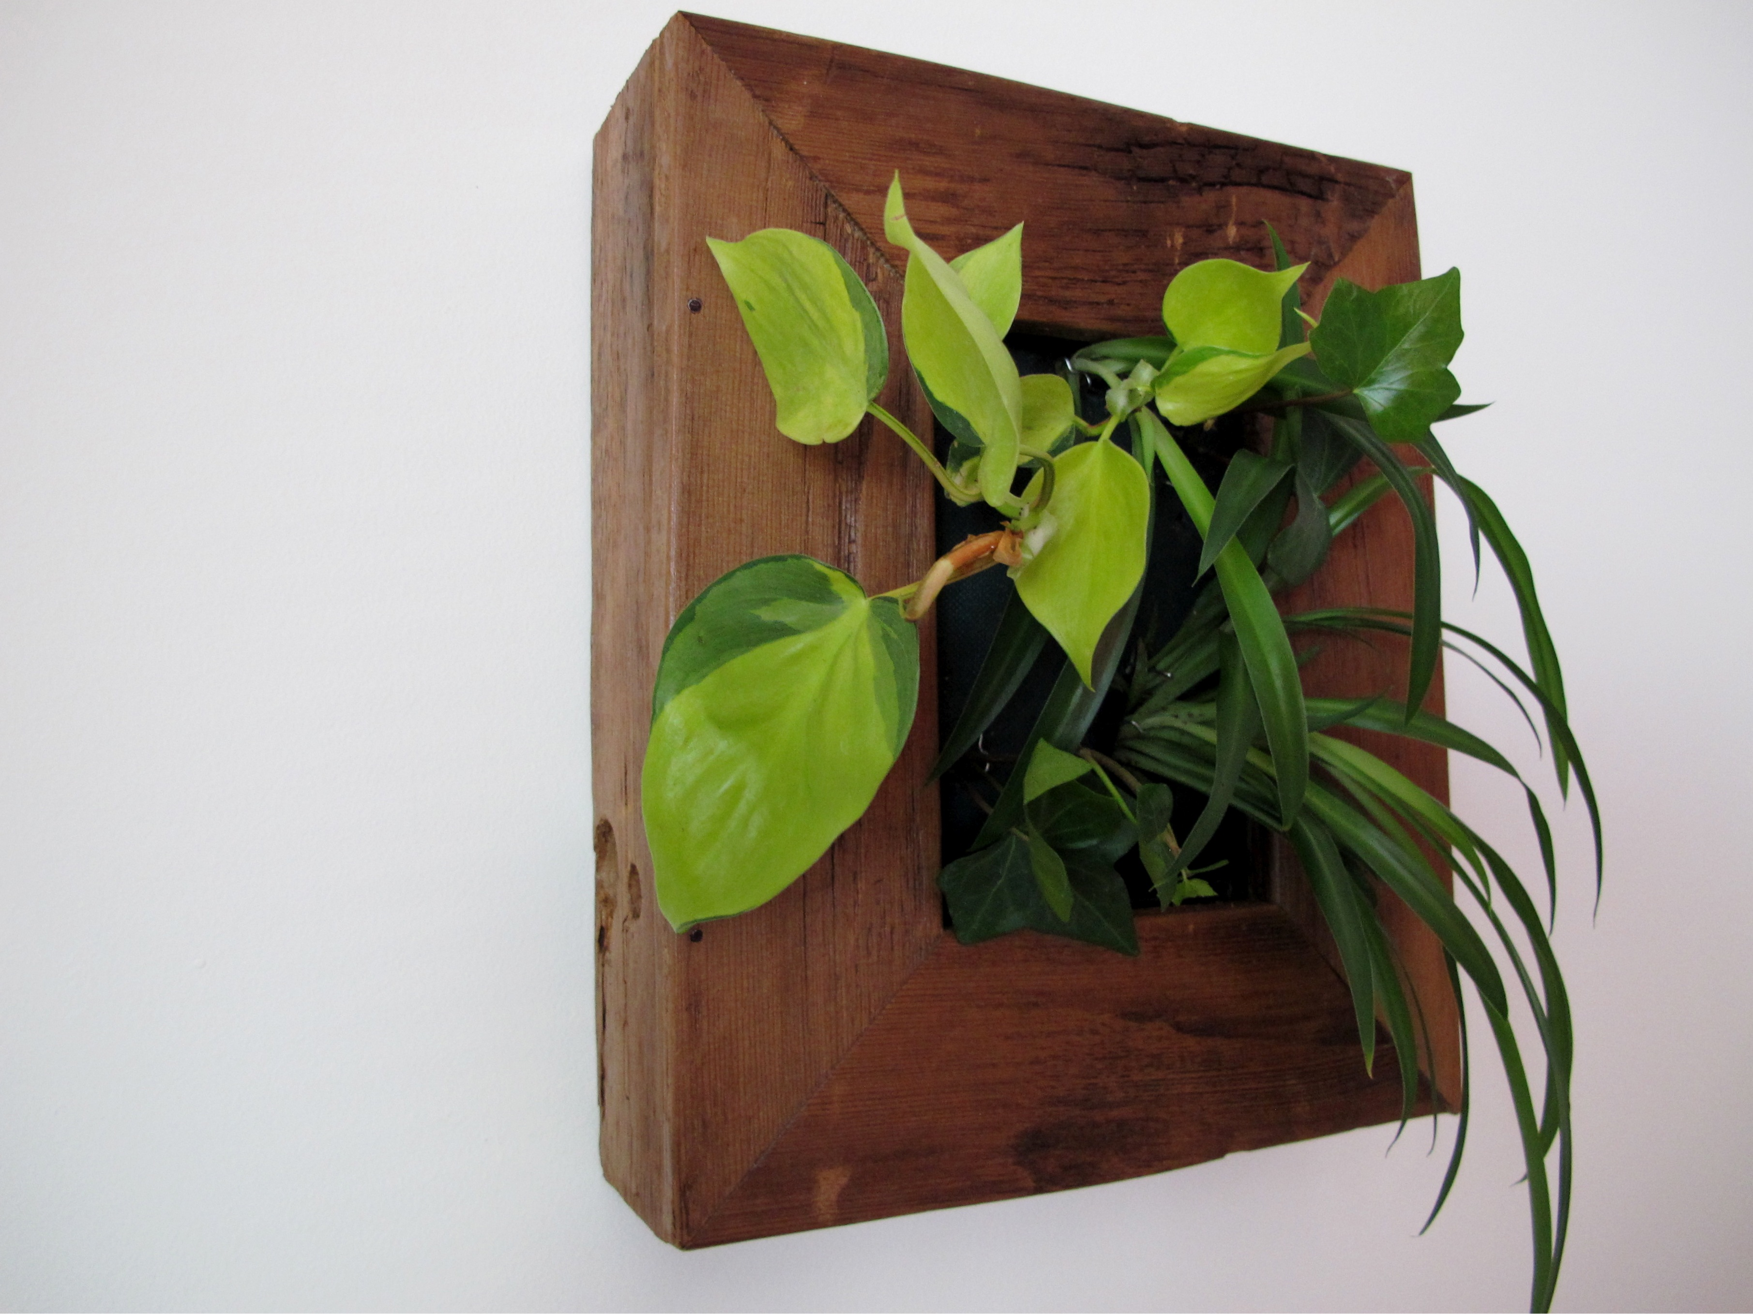
Natural Capital in Cities
Notes:
The David Suzuki Foundation has chosen to focus on Natural Capital in urban areas. This project is focused on educating urban Canadians on the importance of the goods and services provided by green space, and farmland and ensuring that these benefits are accounted for and protected in municipal land use planning. This is a national project with a focus on the southern Ontario Golden Horseshoe, the BC Lower Mainland (which you’ll be focusing on) and the Montreal Community Region. The rapid increase in population and intensity of land use is placing unprecedented pressure on the natural capital assets of these regions, such as forests, wetlands, farmland and other natural and managed ecosystems.
Key message: Within cities, we tend think of nature as something out there; that its utility in the city is generally confined to recreational pursuits. But nature within and surrounding our communities provides much more than a place to jog or have a picnic. These ecosystems provide a vast array of ecological services and benefits that are virtually priceless.
Our work is generally comprised of two distinct phases: (1) the completion of natural capital reviews of urban and near-urban green space and farmland; and (2) public engagement. The purpose for the first phase of the project is to complete land cover inventories and ecosystem services valuations of the natural capital assets of targeted urban regions (remnant forests, wetlands etc.). The purpose of the second phase is to promote awareness about the importance of natural capital and to engage key influencers and decision-makers to advocate for its protection in municipal land use planning processes.

Slide 7
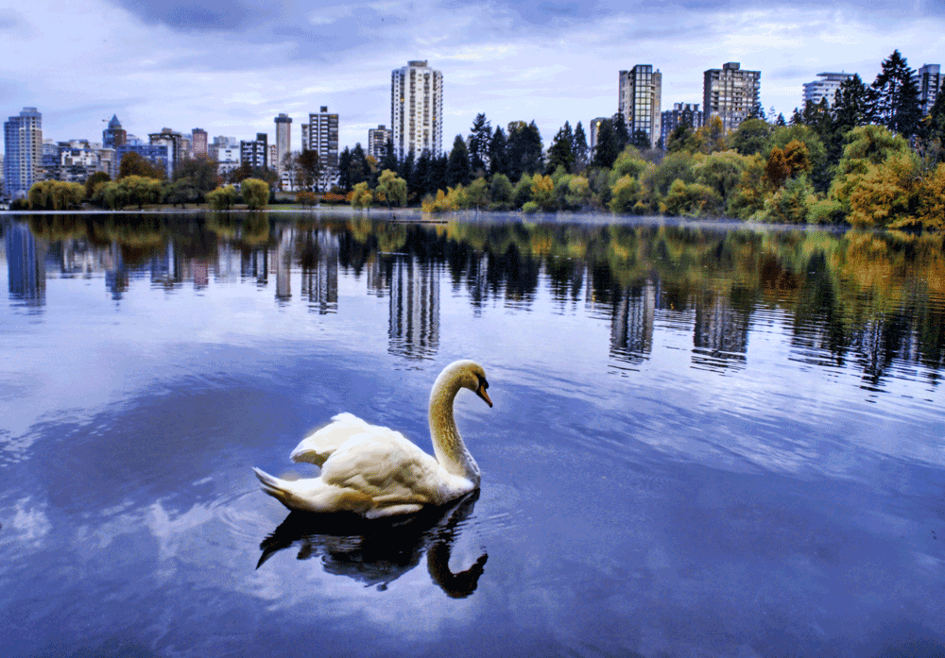
Natural Capital in the Lower Mainland – What we’ve done
Notes:
Over the past 2 years we’ve completed the first phase of work – the background research – for the Lower Mainland, and we’re now gearing up for the second phase of work – the public engagement phase.
We’ve completed natural capital valuations for both the terrestrial and aquatic ecosystems of the Lower Mainland. We’ve also completed some policy analysis – we looked at tools that municipal and regional governments can use to protect, preserve and restore NC.
Our strategic assessment indicates a focus on local engagement around wetlands conservation. Our analysis conducted during the 1st phase of research indicated that wetlands are of high value (wetlands’ are among the most productive of ecosystems); they are highly degraded & threatened; and there are political opportunities open for their protection. So all signs point to wetlands

Slide 8
Wetland Ecosystem Services (worth from $3,000 - $380,000/hectare/yr)
Aesthetic & Recreational
Disturbance Regulation
Habitat Refugium & Nursery
Waste Treatment
Water Supply
Carbon Storage
Notes:
We were able to value 6 services provided by wetlands. They represent a fraction (about 35%) of known wetland services.
Aesthetic & recreational – This refers to the appreciation of and attraction to beautiful natural land and seascapes, as well as the use of nature for recreational purposes
Disturbance regulation – Intact ecosystems provide protection from storms, storm surges, tsunamis and other disturbances. Such ecosystems are able to absorb and store large amounts of rainwater or water runoff during a storm, in addition to providing a buffer against coastal waves. Wetlands are particularly important for absorbing floodwaters
Habitat refugium & nursery - Habitat may provide refugium and nursery functions. A refugium refers to general living space for organisms, while nursery habitat is specifically habitat where all the requirements for successful reproduction occur
Waste treatment - Microorganisms in sediments and mudflats of estuaries, bays, and nearshore areas break down human and other animal wastes. They can also detoxify petroleum products. Wetland biota play a crucial role in removing nitrogen and phosphorous from water
Water supply – Ecosystems absorb water during rains and release it in dry times, and also regulate water temperature and flow for plant and animal species. Wetlands contribute to modulating the flow of water from upper portions of the watershed to streams and rivers in the lower watershed as well as recharging groundwater.
Carbon Storage - Wetlands sequester carbon within standing biomass (vegetation), but significantly more is stored within soils, which can remain undisturbed for thousands of years, if not millennia

Slide 9
Some services we didn’t value
Culture
Spiritual
Cognitive benefits
Health benefits
Notes:
As I mentioned, we weren’t able to value all ecosystem services. Sarah has indicated that you’ll be focusing on cultural services. I just wanted to reinforce the range of services under this broad heading
Cultural services represent the non-material benefits people obtain from ecosystems through the development of spiritual, cognitive, community and aesthetic-based activities. The intangible nature of these services makes them difficult to value in a quantitative manner, nor are they easily duplicated.
These environments provide a rich source of inspiration for art, music, folklore, national symbols, architecture, etc. Being land-based animals, humans have long regarded the natural movements, sounds, and diversity of aquatic realms as sources of rejuvenation and a means of obtaining a fresh perspective. It is not surprising that many religions attach spiritual and religious values to these ecosystems and/or their components.
Intact ecosystems also provide health benefits. Exposure to nature can be the best prescription for stress and illness. Benefits of time spent in nature can include improved cognitive functioning and increased overall well-being. Research shows that even simple and brief interactions with nature can produce marked increases in cognitive control.

Slide 10
Goals and objectives (where we’re heading)
Long term goals
To foster a stronger connection and greater awareness among urban Canadians of the importance of natural capital, and the ecosystem benefits it provides in sustaining community health and wellbeing.
The highest value ecosystems within and servicing the Lower Mainland are protected
High value ecosystems are connected within the Lower Mainland
Through effective regulation, management, and/or incentive structures, the Lower Mainland is managed within a nested, multi-scale EBM framework
Notes:
LT goals of significance:
First goal – Student work should foster a stronger connection to wetlands
Final goal – Note that wetland protection can and should occur across a range of scales – from the backyard to the regional district

Slide 11
2012-2013 Objectives
Re-establish a strong commitment by municipal decision-makers to protecting high value natural capital areas and their connectivity
Natural Capital Accounts – Municipal decision-makers begin ongoing reporting of Natural Capital values
Identify funding mechanisms to enhance protection of high value ecosystems, particularly wetlands
Notes:
2012-2013 objectives
- First objective of most relevance. We would like the community to support stronger wetland protection goals

Slide 12
PE Projects
Meetings and workshops with regional government, First Nations, and industry
Support wetland leaders
Social media: Natural Capital Map, Emily Carr partnership, blogs, op-eds, facebook, etc
Notes:
PE components:
Meetings and workshops to explain product and how it can inform decision-making
Support wetland leaders we identified through the Wetland Leadership Forum
Social Media: NatCapMapApp, Emily Carr work, blogs, op-eds, facebook, twitter

Slide 13
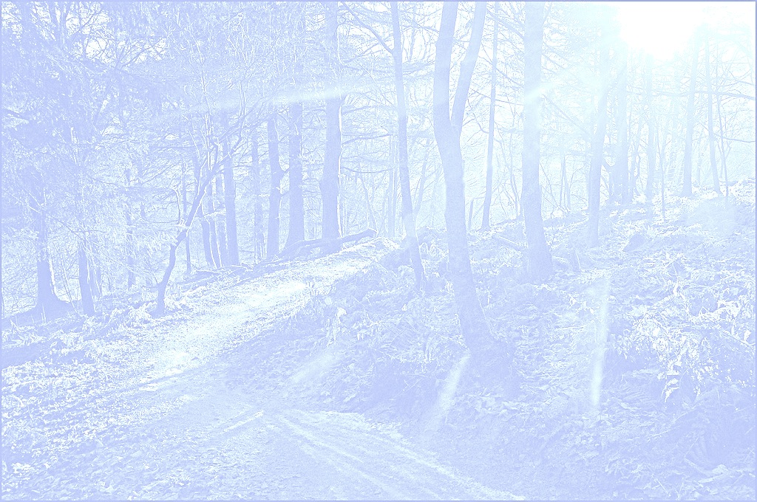

Where your work fits in:
Notes:
Your work will be a part of our outreach to the general public
Your videos should
Engage a diverse cross-section of Vancouver’s residents
Address the value of ecosystem services. (You may be focusing on cultural services)
Encourage our communities and politicians to protect these services

Slide 14
Vancouver’s Wetlands
https://earthbuilder.google.com/10497219480104721454-09165464699497016914-4/mapview/.
Notes:
Map of Vancouver wetlands.
We have not completed any valuation work on specific wetlands, but I can obtain more information on these wetlands from Metro Vancouver

Slide 15
Key Audiences
Metro Vancouver residents (primary)
Lower Mainland residents (primary)
Local governments (secondary)
Industry & business (secondary)
Notes:
While some residents may not self-identify as environmentalists, they directly benefit from some or all of the services that local wetlands provide. By targeting those with a strong connection to their community through a sense of civic pride, we can encourage a new audience by demonstrating the tremendous value nature offers.
Secondary audiences include local government and industry/business. Ideally, we’d like the primary audience to influence the secondary audiences to consider natural capital

Slide 16
Key messages
There is no right way to value nature, but there is a wrong way
Nature exists in our cities
The economy exists within nature and must respect its limits

Slide 17
Possible venues for your work:
NatCapMapApp: http://www.davidsuzuki.org/issues/wildlife-habitat/projects/natural-capital/putting-natural-capital-on-the-map/.
Making Policy Live: http://www.davidsuzuki.org/issues/wildlife-habitat/projects/natural-capital/making-policy-live/.
Other?: http://www.youtube.com/watch?v=TartoYpK1yI.

Slide 18
Thank you
Michelle Molnar
mmolnar@davidsuzuki.org
(604) 732 4228 ext. 1259
Heidi Hudson
hhudson@davidusuzki.org
(604) 732 4228 ext. 1241
Notes:
Conclude with thanks and the hope that we will be able to work together more in the future

